Slide 1
Amazon SageMaker Workshop

Slide 2
Agenda
Amazon SageMaker overview
Q & A
Setup for Workshop
Hands-on Workshop modules

Slide 3
Amazon SageMaker overview

Slide 4

Amazon SageMaker
A managed service that provides the quickest and easiest way for data scientists and developers to get
ML models from idea to production.

Slide 5
Components of Amazon SageMaker used in the Workshop
UX
Training
Hosting
Amazon’s fast, scalable algorithms
BYO script for ML frameworks
BYO algorithm
Automatic Model Tuning

Slide 6
Amazon SageMaker is Modular
Examples of adapting SageMaker to your workflow:
UX: Using a SageMaker notebook is convenient, but not necessary. Perhaps you prefer RStudio running on EC2 instead; that’s fine! Or scripts, or CLI . . . .
Training: SageMaker automates setting up and launching training clusters, but you can continue using your own training cluster.
You also can take a SageMaker-trained model elsewhere. . . .
Hosting: if you’re using your own training cluster, you can bring your model trained there into SageMaker hosting.

Slide 7
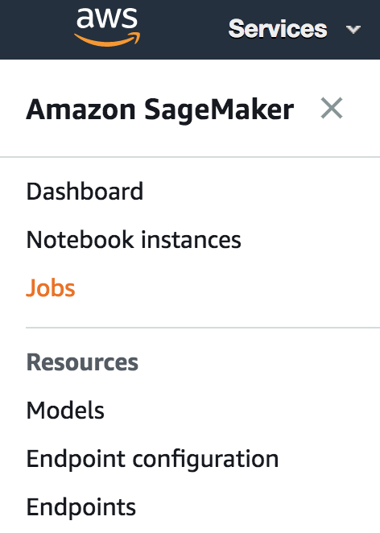

UX Choices
Use SageMaker‘s hosted Notebook Instances...
… or Apache Spark through EMR and the SageMaker Spark SDK...
... or SageMaker‘s Console for a point and click experience...
... or your own device (EC2, laptop, etc.)

Slide 8

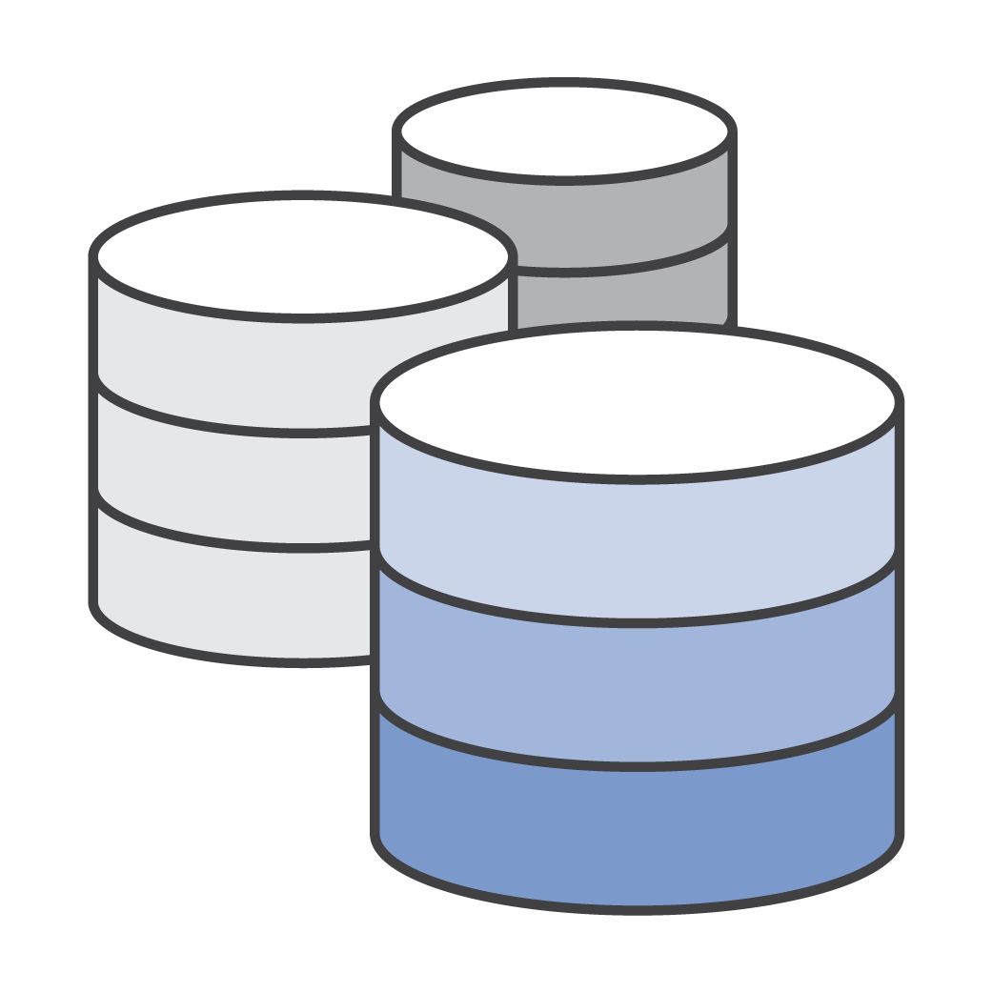
Training: Automated Hardware/Cluster Management
Zero setup
Support for streaming datasets + distributed compute
Docker / ECR under the hood (but you don’t need to touch it)
Deploy trained models locally, to SageMaker, or to edge devices such as DeepLens

Slide 9

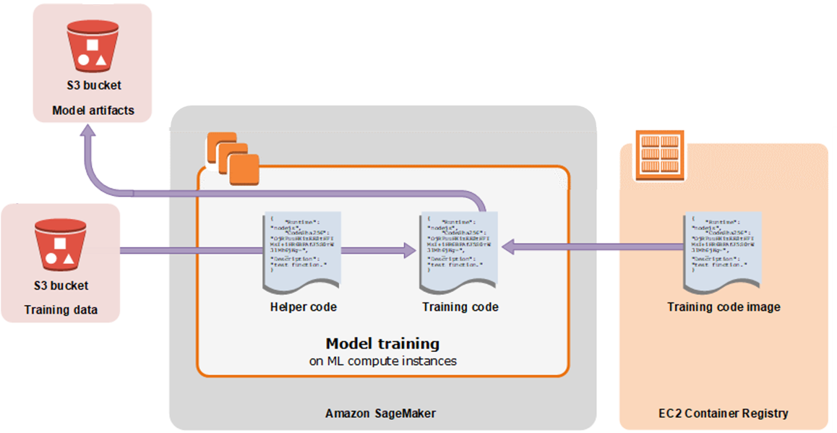
Training: data into S3, models out to S3, run anywhere with Neo
SageMaker Neo

Slide 10
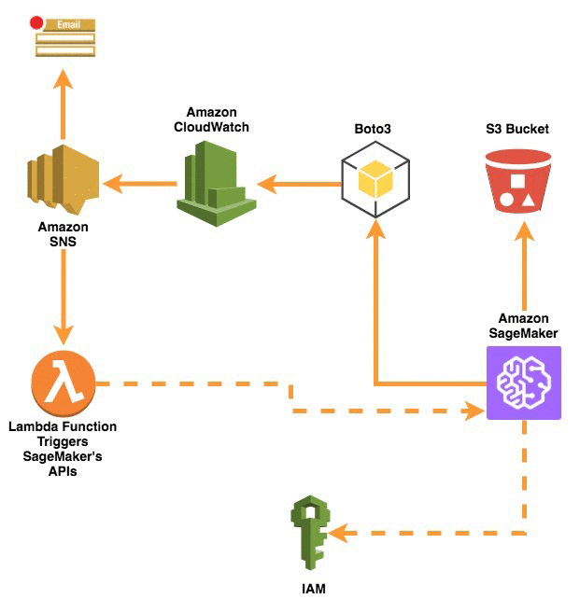
Training: Automated Workflows

Slide 11
Training: Built-in Algorithms for Web Scale
“General Purpose”:
Factorization Machines
K-Means
K-NN
Linear Learner
Object2Vec
PCA
XGBoost
NLP:
LDA
Neural Topic Model
Seq2Seq
BlazingText
Computer Vision:
Image Classification
Object Detection
Semantic Segmentation
Application Specific:
DeepAR
IP Insights
Random Cut Forest
Algorithms in blue font are neural net-based

Slide 12




Training: BYO Script Mode with Prebuilt Containers
Sample your data…
… explore and refine models in a Notebook Instance
Use the same code to train on the full dataset in a cluster of GPU instances…
… deploy to production

Slide 13



Training: Bring Your Own Algorithm (BYOA) using Docker
etc.
Amazon ECR
Pick your preferred technology...
... add algorithm code to a Docker container...
... publish image to ECR

Slide 14






Hosting: Automated Model Deployment & Autoscaling
One step deployment
Fast, reliable
real time and batch inference
A/B testing
built-in
Use your own model
Optimize with Neo and Elastic Inference

Slide 15



















There is more to SageMaker & the AWS ML Stack:
Vision
Speech
Language
Chatbots
Forecasting
Recommendations
AI SERVICES
REKOGNITION
IMAGE
REKOGNITION
VIDEO
TEXTRACT
POLLY
TRANSCRIBE
TRANSLATE
COMPREHEND
LEX
FORECAST
PERSONALIZE
AMAZON SAGEMAKER
ML SERVICES
BUILD
TRAIN
DEPLOY
Pre-built algorithms & notebooks
One-click model training & tuning
One-click deployment & hosting
Data labeling (GROUND TRUTH)
Optimization (NEO)
Algorithms & models (AWS MARKETPLACE
FOR MACHINE LEARNING)
Reinforcement learning
Frameworks
Interfaces
Infrastructure
ML FRAMEWORKS & INFRASTRUCTURE
EC2 P3 & P3N
EC2 C5
FPGAs
GREENGRASS
ELASTIC INFERENCE

Slide 16
Q&A

Slide 17
Getting Started on the Workshop

Slide 18
Workshop Options
We’ll cover 3 fundamental categories of ML in SageMaker: working with structured data, computer vision, and natural language processing.
All labs/modules are independent and can be completed in any order, EXCEPT the Extra Credit module. However, we recommend starting with the first module.
You have a choice of two different workshops, depending on your experience level and interests:
Introduction to SageMaker: a workshop covering the basic components of SageMaker.
TensorFlow in SageMaker: a more in-depth workshop for TensorFlow users and experienced machine learning practitioners.

Slide 19
Introduction to SageMaker Workshop
There are three main modules and one Extra Credit module in this workshop:
Structured Data Use Case – Videogame Sales: use the XGBoost algorithm to predict whether a videogame will be a hit.
Computer Vision Use Case – Image Classification: use SageMaker’s built-in Image Classification algorithm to classify images.
NLP Use Case – Sentiment Analysis: define your own sentiment analysis model with TensorFlow and apply it to a dataset of movie reviews.
Extra Credit – Videogame Sales Using Scripts, the CLI and Console: while the above modules use Jupyter notebooks, this module shows other ways to use SageMaker.

Slide 20
TensorFlow in SageMaker Workshop
There are three main modules in this workshop:
NLP Use Case – Sentiment Analysis: train a textCNN to classify movie reviews as positive or negative, and perform batch inference on a set of reviews.
Structured Data Use Case – Boston Housing: while training a regression MLP to predict house prices, use Automatic Model Tuning to find the best hyperparameters.
Computer Vision Use Case – Image Classification: train a CNN from scratch to classify images using a cluster of machines and Horovod; deploy a real time endpoint with Elastic Inference for lower cost GPU-accelerated predictions, and also perform batch inference on PNG images with SageMaker-provided data transform functionality.

Slide 21
Setup for the Workshop
1. Go to this link and review the prerequisites:
https://github.com/awslabs/amazon-sagemaker-workshop
2. Go to the workshop of your choice.
3. Complete the preliminaries, including downloading the repository.
4. Follow all steps through “Creating a Notebook Instance.”
5. Continue on through the use case modules.

Slide 22
Thank you!
https://github.com/awslabs/amazon-sagemaker-workshop

